Slide 1
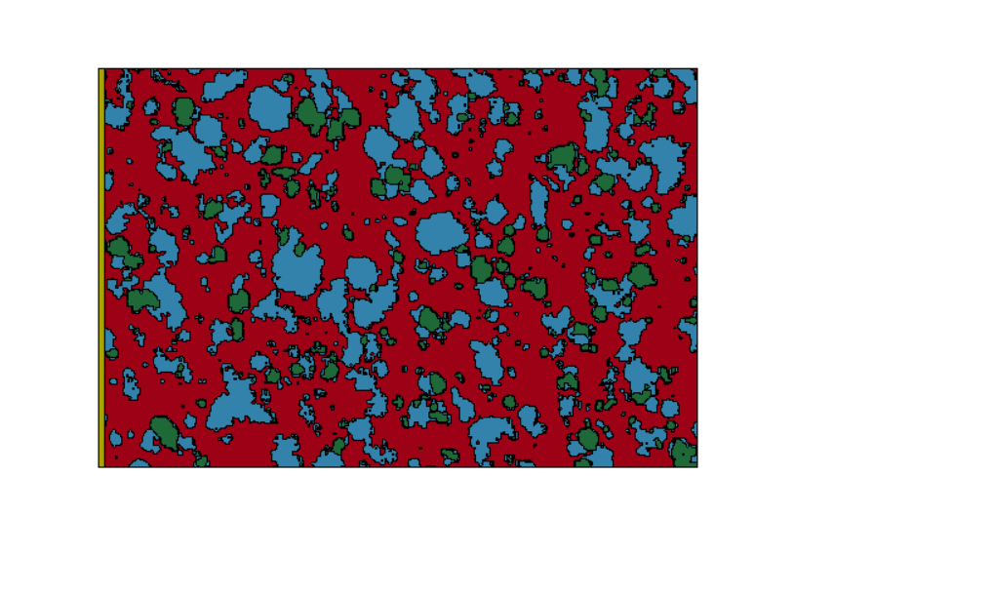
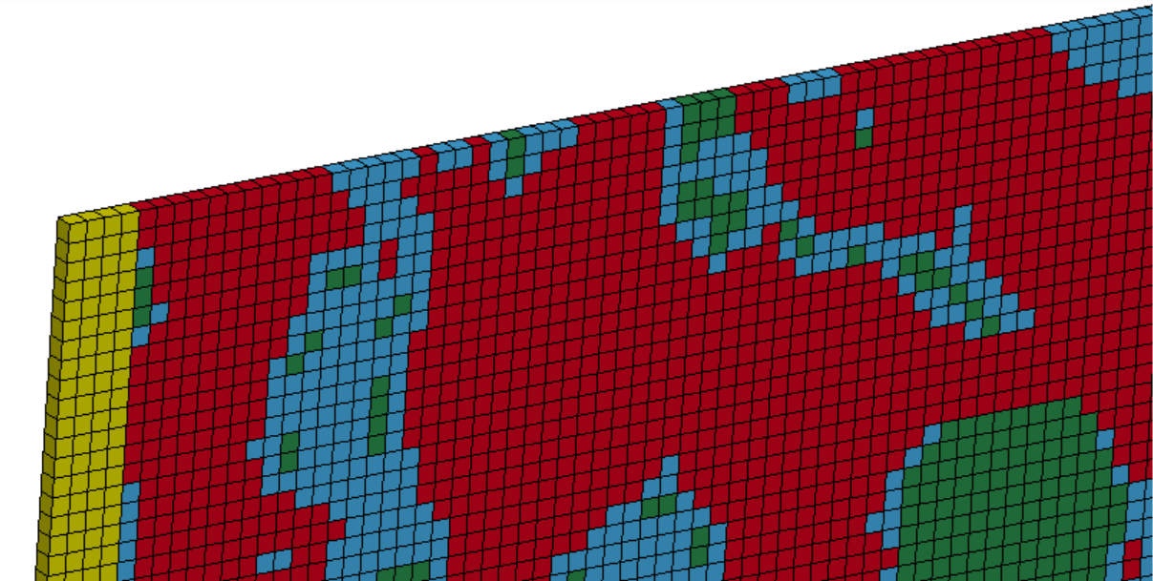
Description of a fluid-solid interaction (FSI) problem:
The yellow rigid (as solid) wall on the left compresses a mixture of three different materials (as fluid) on the right at constant velocity v .
Quasi 2D model
v
Rigid wall area
Lagrange grid（solid）
The mesh adopts Soild element, which has a very thin thickness.
Mixture area of three different materials
muti-material Euler grid（fluid）

Slide 2
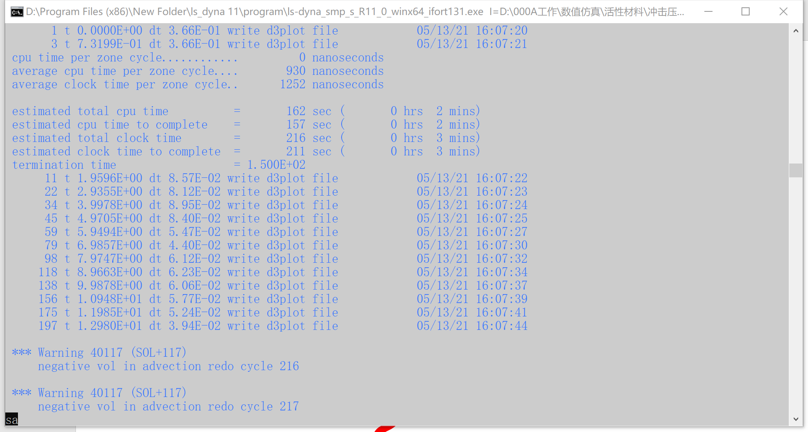
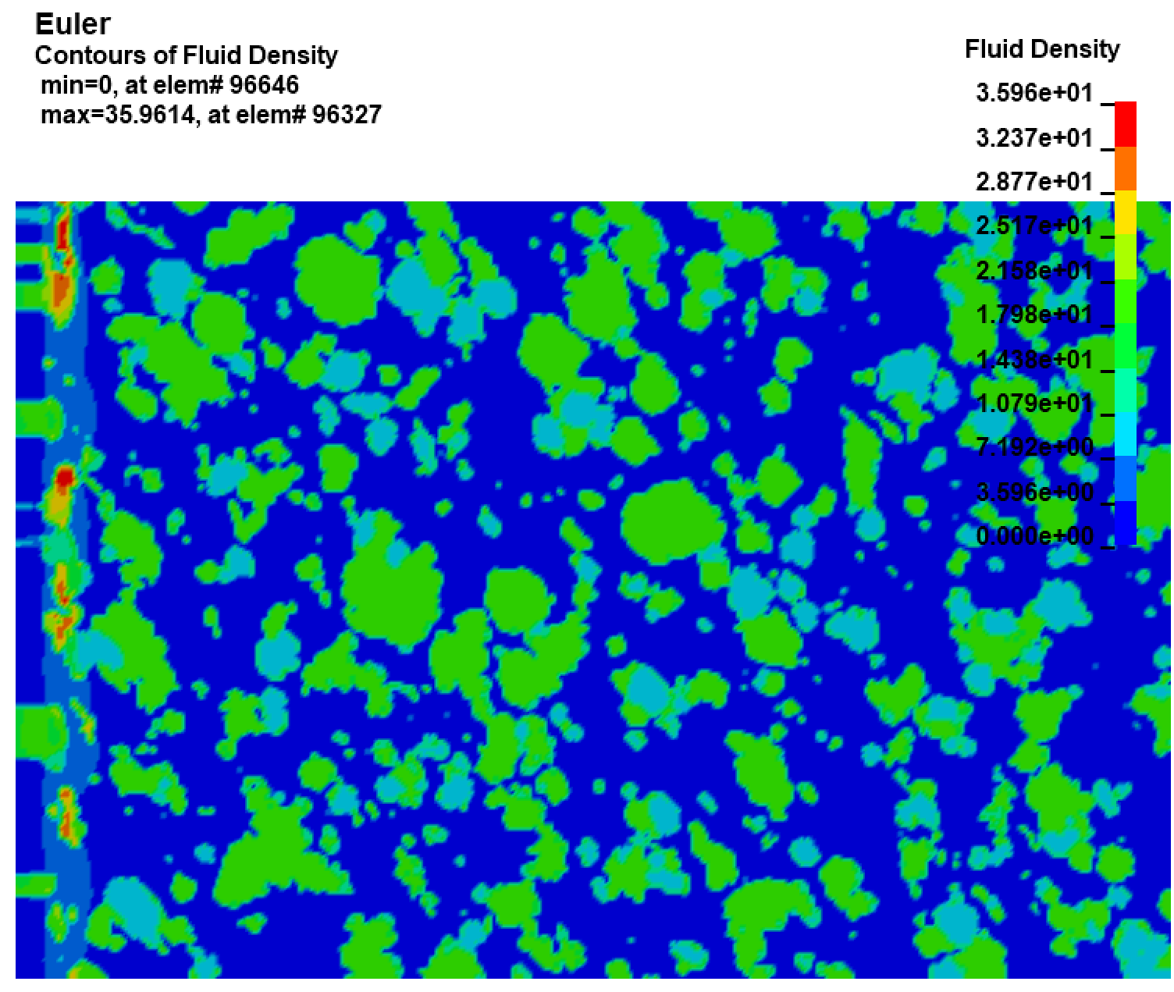
Current error simulation result
Contours of Fluid Density
Negative volume appear, so the calculation stop.
The rigid plate on the left pushed and compressed the fluid on the right. There should be no fluid in the place where the rigid plate passed (it will become viod area), and all the fluid should be compressed to the right side of the plate. But in this calculation result (contours of fluid density), there was still fluid on the left side of the plate, and the fluid was continuously stretched, so the calculation shows negative volume, and an error is reported.
Shock wave front
?
This is contrary to the calculation result of the Ref. on the next page. What is going on? Could it be that there is a problem with the FSI setting, causing the fluid to pass through the rigid plate?
Compressed fluid
Rigid wall
Stretched fluid

Slide 3
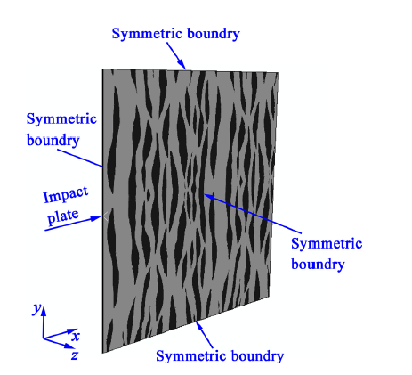
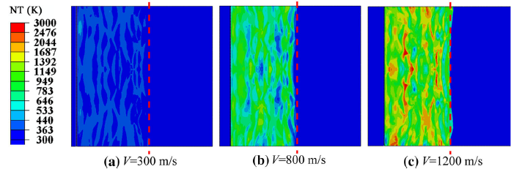
Reference calculation results:
Calculated in ABAQUS
https://doi.org/10.1007/s10853-019-03357-3
Correct simulation result in the Ref.
Shock wave front
Viod area
Impact plate
(Rigid wall)
Compressed mixture
The fluid is all driven by the rigid plate to the right side of the plate, so there is no fluid on the left side of the plate.

Slide 4
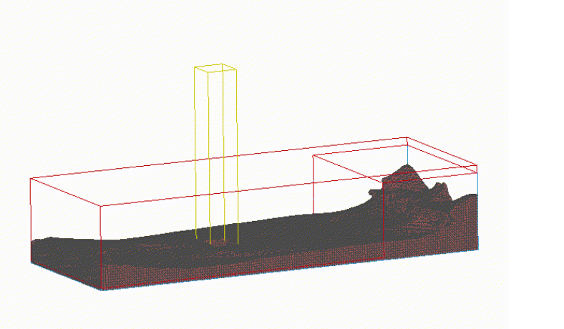
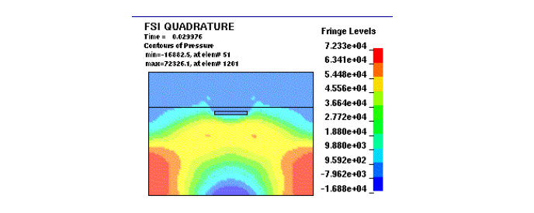
LS-DYNA official reference examples:
Wave-Structure Interaction:
https://www.dynaexamples.com/ale/intermediate-example/wavestructure
The plate hits the water:
https://www.dynaexamples.com/ale/fsi

